Slide 1
Sleep & Lifestyle Insights

Slide 2
AGENDA
INTRODUCTION
OVERVIEW
KPI’S
INSIGHTS
RECOMMENDATIONS
SUMMARY
CONCLUSION

Slide 3
INTRODUCTION
OVERVIEW : This Lifestyle & Sleep Insights Dashboard in Excel visually summarizes key health and activity metrics like daily steps, heart rate, and BMI distribution. It uses interactive filters for gender and occupation, making it easy to explore trends. The charts highlight how physical activity and health vary by demographics, BMI categories, and job roles, providing clear insights to improve wellness and productivity.
OBJECTIVE : The objective of this dashboard is to provide insights into health and activity trends across genders, BMI categories, and occupations, helping to support better health decisions and promote overall well-being.
DATA SOURCE : The data for this dashboard comes from lifestyle and health metrics, including daily steps, heart rate, BMI, gender, and occupation details. It is organized to analyze patterns and relationships between physical activity, health, and demographics.

Slide 4

TOOLS USED
Microsoft Excel is a tool that helps you organize and work with data. You can use it to create tables, do calculations, make charts, and analyze information. It’s great for tasks like managing budgets, tracking projects, or creating reports. People use it at work, school, and home to handle numbers and data easily.

Slide 5
Where did you get the data from ?
Got it from open source

Slide 6
AIM OF THE PROJECT
The aim of this project is to explore and display health and lifestyle data, like daily steps, heart rate, and BMI, to understand how these factors vary by gender, occupation, and BMI. It helps to provide useful insights that can improve personal health and support better wellness programs. This allows users to gain meaningful insights into how lifestyle habits and physical activity levels vary among different groups, helping to support better health decisions, improve individual well-being, and create targeted wellness programs. The dashboard also serves as a valuable tool for organizations or researchers looking to assess health trends and design effective strategies for promoting healthier lifestyles.

Slide 7
KPIS FOR ANALYSIS
Average Daily Steps by Gender :
Males may have higher steps due to occupation demands, while females might show lower counts based on roles or routines.
Average Heart Rate by Gender :
Highlights gender-based differences in cardiovascular health, with variations possibly linked to fitness or stress levels.
BMI Count by Gender :
Shows BMI category distribution by gender, aiding in identifying groups needing targeted health interventions.
Average Daily Steps by BMI Category :
Normal BMI individuals tend to be more active, while overweight/obese categories show lower activity levels.
Average Daily Steps by Occupation :
Physical activity varies by job roles; active jobs like nursing show higher steps compared to sedentary roles like IT.

Slide 8
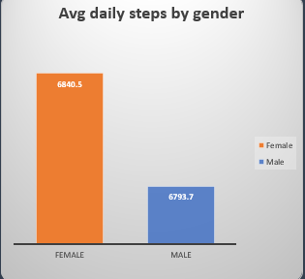
Average Daily Steps by Gender
KPI 1
Average Daily Steps by Gender tracks how many steps males and females take on average each day. This helps us understand how physical activity differs between the two groups. By looking at this data, we can identify which gender may need more encouragement to be active and create programs that promote healthier lifestyles for both. This information helps improve overall health by encouraging more balanced activity levels for everyone.

Slide 9
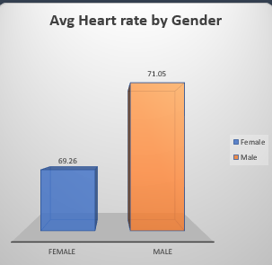
Average Heart Rate by Gender :
KPI 2
The Average Heart Rate by Gender chart shows the average heart rate for males and females. This information helps compare cardiovascular health between the two genders. Typically, males and females may have different average heart rates due to factors like fitness level, stress, or body composition. If males have a higher heart rate, it might reflect differences in physical conditioning or other health-related factors.

Slide 10
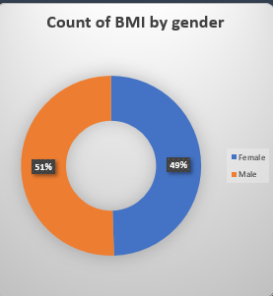
BMI Count by Gender
KPI 3
The BMI Count by Gender chart displays the distribution of individuals across different BMI categories (e.g., underweight, normal, overweight, and obese) based on gender. This chart helps to show how body weight varies between males and females. It can provide insights into the percentage or count of males and females within each BMI category. This data is useful for identifying health risks and creating targeted wellness programs for both genders.

Slide 11
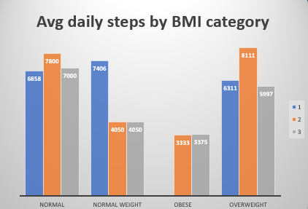
Average Daily Steps by BMI Category
KPI 4
The Average Daily Steps by BMI Category chart shows the number of daily steps taken on average by individuals in different BMI categories, such as normal weight, overweight, and obese. This chart helps us understand how physical activity levels vary with body weight. Typically, people in the normal BMI category tend to take more steps daily, reflecting a healthier, more active lifestyle. In contrast, individuals in the overweight and obese categories generally show fewer daily steps, which could indicate lower physical activity levels. This data is useful for identifying potential health risks related to inactivity and for creating programs that encourage increased physical activity, especially for those in higher BMI categories.

Slide 12
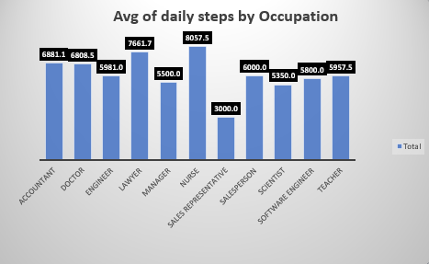
Average Daily Steps by Occupation
KPI 5
The Average Daily Steps by Occupation chart shows the average number of steps taken daily by individuals in different job roles. It helps highlight how occupation impacts physical activity levels. This information can help identify occupations where employees may need encouragement to be more active and can guide workplace wellness programs to promote healthier lifestyles. Physical activity varies by job roles active jobs like nursing show higher steps compared to sedentary roles like IT.

Slide 13
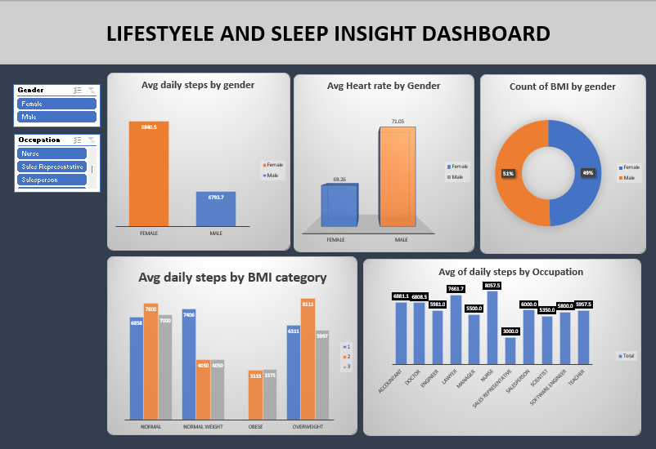

Slide 14
INSIGHTS OF PROJECT
Females generally take more daily steps than males, suggesting higher activity levels, though this can vary based on their roles and routines. Males, on the other hand, show a slightly higher average heart rate compared to females, which might indicate differences in fitness levels, stress, or health conditions.
BMI categories are nearly evenly distributed across genders, with minor variations reflecting factors like lifestyle, diet, or genetics. People with a normal BMI are typically more active, taking more steps daily, while those in overweight or obese categories tend to have lower activity levels, emphasizing the need for targeted health interventions.
Occupations also play a significant role in activity levels. Physically demanding roles, such as nursing, have higher average step counts, while sedentary professions show lower activity, pointing to opportunities for workplace wellness initiatives to promote healthier lifestyles.

Slide 15
RECOMMENDATIONS
Encourage men to increase their daily activity levels through fitness programs and support women in staying active, especially in desk jobs. This will help create a balance in physical activity between genders.
Provide special programs for people with higher BMI, like walking challenges or fitness plans, to help them become more active and improve their health. Educating them about how exercise can help with weight management can make a big difference.
Introduce wellness activities at workplaces with less movement, such as standing desks or short breaks for walking, to promote healthier routines and boost energy levels.
Track heart rate patterns to spot any health risks and offer tips for managing stress or improving fitness tailored to each gender’s needs.

Slide 16
SUMMARY
This project analyzes lifestyle and health data, focusing on daily activity, heart rate, and BMI across genders and occupations. It highlights that females are generally more active, while males have slightly higher heart rates. People with normal BMI are more active compared to those in overweight or obese categories, showing the need for targeted health programs. Occupations also affect activity levels, with physically demanding jobs being more active than sedentary ones.

Slide 17
CONCLUSION
The project shows that lifestyle and health habits vary by gender, BMI, and occupation. It highlights the importance of staying active, especially for those in sedentary jobs or with higher BMI. Encouraging regular physical activity and creating supportive environments can lead to healthier lives for everyone, regardless of their job or body type. With the right programs and awareness, people can lead healthier and more balanced lives. It suggests that people in sedentary jobs or with higher BMI may benefit from more support to become active.

